Slide 1
ALA 2010 : Cataloging for Weeding & Retention
Krista E. Clumpner
Head, Technical Services and Systems
Olson Library. Northern Michigan University
kclumpne@nmu.edu

Slide 2
ALA 2010 : Cataloging for Weeding & Retention
Basic information: NMU
  4 year undergraduate with some Masters
  Approximately 9500 students
  Four colleges –
    College of Arts & Sciences
    College of Professional Studies
    College of Business
    Division of Academic Information Services
  One library with 734,003 items

Slide 3
ALA 2010 : Cataloging for Weeding & Retention
  One library with 734,003 items
  80 – 20 rule
  Statistically true for entire collection.
  So, approximately 587,203 not used

Slide 4
ALA 2010 : Cataloging for Weeding & Retention
By 2015, reduce the main print book collection housed on the third floor by 50%. Considerations include:
  Retaining sufficient collections to ensure that Interlibrary Loan and MeLCat lending are not jeopardized.
  Preserving significant collections: Holocaust and collections of local significance.
  Maintaining core discipline-centered collections.

Slide 5
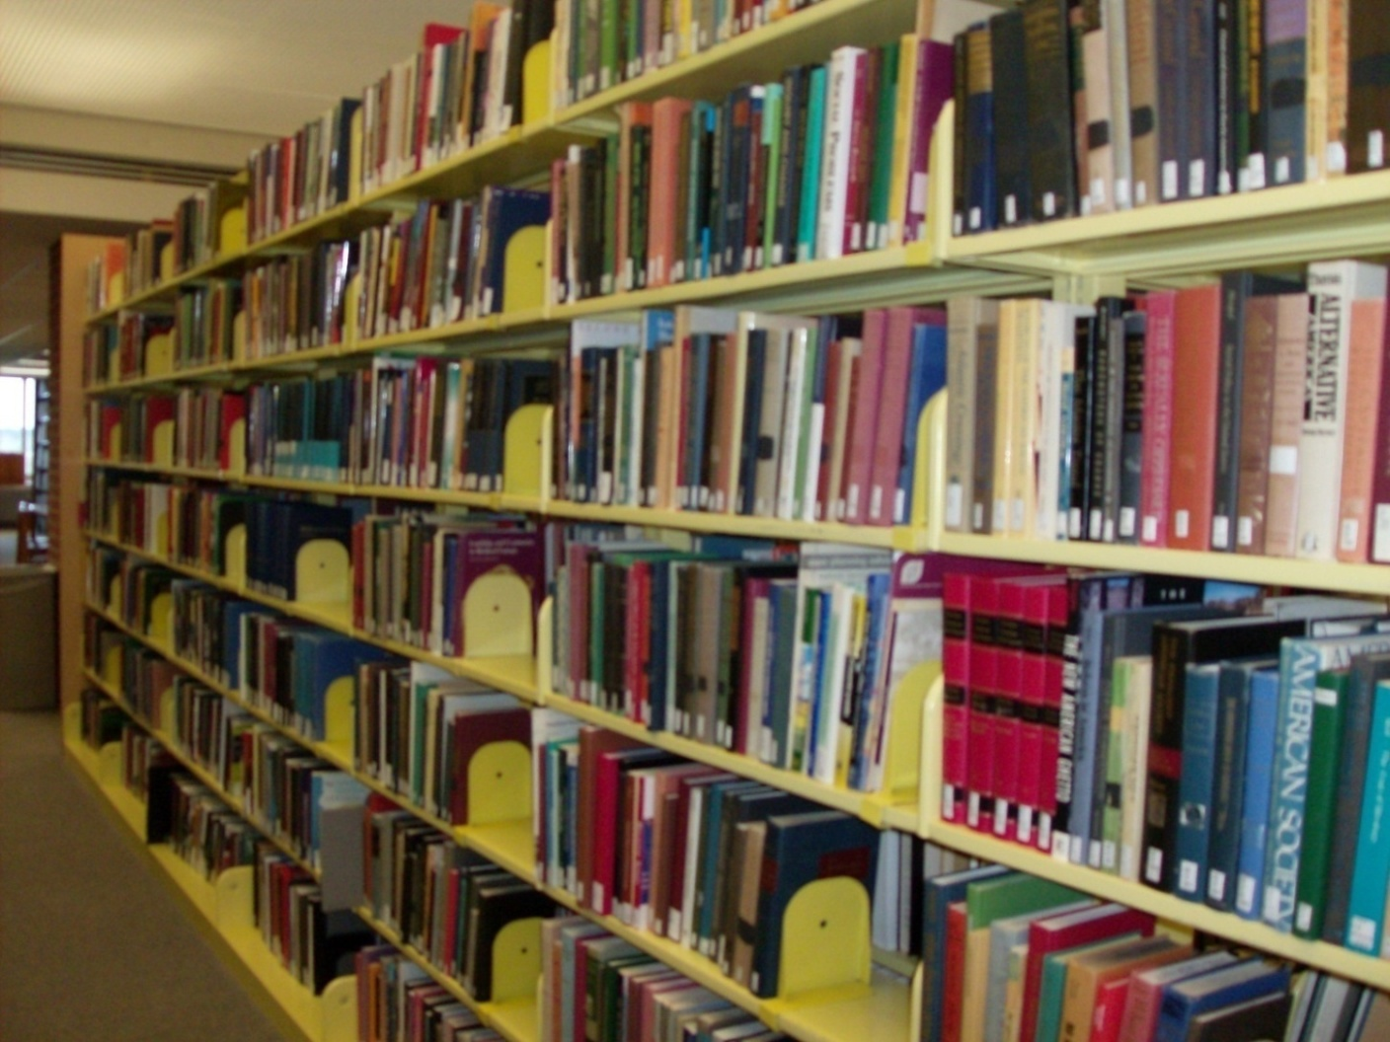
ALA 2010 : Cataloging for Weeding & Retention

Slide 6
ALA 2010 : Cataloging for Weeding & Retention
What to weed? What to keep?
Zero-use items
  Check outs: circ history Fall 1991 to date
  Browses: since migration in April 2001
  ILL: handled through circulation so counted

Slide 7
ALA 2010 : Cataloging for Weeding & Retention
What to weed? What to keep?
Zero-use items
Classics
  Books for College Libraries (BCL)
    1st, 2nd, and 3rd editions in print
    Each edition stands on its own, does not replicate earlier ed.
  Resources for College Libraries (RCL)
    On the web: http://www.rclweb.net/

Slide 8
ALA 2010 : Cataloging for Weeding & Retention
What to weed? What to keep?
Zero-use items
Classics
Unique titles
  NMU imprints
  NMU Faculty publications
  WorldCat
    How many within Michigan hold?
    Four or more = not unique

Slide 9
ALA 2010 : Cataloging for Weeding & Retention
What to weed? What to keep?
Zero-use items
Classics
Unique titles
Duplication of content
  Compare print to databases
    ArtStor vs. Museum Collections
    Available as an eBook

Slide 10
ALA 2010 : Cataloging for Weeding & Retention
Process:
  Using the zero-use list
  Pull information from ILS (Voyager)

Slide 11
ALA 2010 : Cataloging for Weeding & Retention
Zero-use Report using Microsoft Access
  Get item ID and barcode from location, never charged and browsed less than 2
  For each item grab title, pub date, author, etc
  Grab info on chron, enum, etc
  Normalize the call number sort
  Add info on items currently checked out

Slide 12
ALA 2010 : Cataloging for Weeding & Retention
Zero Use Report: The Microsoft Access Queries that Produce the Report
SELECT ITEM.ITEM_ID, LOCATION.LOCATION_CODE, ITEM.HISTORICAL_CHARGES, ITEM.HISTORICAL_BROWSES, ITEM_BARCODE.ITEM_BARCODE INTO [NMU Zero Use Items 1]
FROM (ITEM INNER JOIN LOCATION ON ITEM.PERM_LOCATION = LOCATION.LOCATION_ID) INNER JOIN ITEM_BARCODE ON ITEM.ITEM_ID = ITEM_BARCODE.ITEM_ID
WHERE (((LOCATION.LOCATION_CODE)="nstacks") AND ((ITEM.HISTORICAL_CHARGES)="0") AND ((ITEM.HISTORICAL_BROWSES)<"2"));SELECT [NMU Zero Use Items 1].ITEM_ID, [NMU Zero Use Items 1].LOCATION_CODE, [NMU Zero Use Items 1].HISTORICAL_CHARGES, [NMU Zero Use Items 1].HISTORICAL_BROWSES, BIB_ITEM.BIB_ID, BIB_TEXT.TITLE_BRIEF, BIB_ITEM.ADD_DATE, BIB_TEXT.PUBLISHER_DATE, BIB_TEXT.PUB_PLACE, BIB_TEXT.PUBLISHER, BIB_TEXT.AUTHOR, BIB_TEXT.ISBN, BIB_TEXT.ISSN INTO [NMU Zero Use Items 2]
FROM [NMU Zero Use Items 1] INNER JOIN (BIB_ITEM INNER JOIN BIB_TEXT ON BIB_ITEM.BIB_ID = BIB_TEXT.BIB_ID) ON [NMU Zero Use Items 1].ITEM_ID = BIB_ITEM.ITEM_ID;SELECT [NMU Zero Use Items 2].ITEM_ID, [NMU Zero Use Items 2].LOCATION_CODE, [NMU Zero Use Items 2].HISTORICAL_CHARGES, [NMU Zero Use Items 2].HISTORICAL_BROWSES, [NMU Zero Use Items 2].BIB_ID, [NMU Zero Use Items 2].TITLE_BRIEF, MFHD_ITEM.ITEM_ENUM, MFHD_ITEM.CHRON, MFHD_ITEM.Year, MFHD_ITEM.MFHD_ID, [NMU Zero Use Items 2].ADD_DATE, [NMU Zero Use Items 2].PUBLISHER_DATE, [NMU Zero Use Items 2].PUB_PLACE, [NMU Zero Use Items 2].AUTHOR, [NMU Zero Use Items 2].ISBN, [NMU Zero Use Items 2].ISSN INTO [NMU Zero Use Items 3] FROM [NMU Zero Use Items 2] INNER JOIN MFHD_ITEM ON [NMU Zero Use Items 2].ITEM_ID = MFHD_ITEM.ITEM_ID;
SELECT [NMU Zero Use Items 3].ITEM_ID, MFHD_MASTER.MFHD_ID, [NMU Zero Use Items 3].BIB_ID, [NMU Zero Use Items 3].HISTORICAL_CHARGES, [NMU Zero Use Items 3].HISTORICAL_BROWSES, [NMU Zero Use Items 3].LOCATION_CODE, MFHD_MASTER.NORMALIZED_CALL_NO, [NMU Zero Use Items 3].TITLE_BRIEF, [NMU Zero Use Items 3].CHRON, [NMU Zero Use Items 3].ITEM_ENUM, [NMU Zero Use Items 3].ADD_DATE, [NMU Zero Use Items 3].PUBLISHER_DATE, [NMU Zero Use Items 3].PUB_PLACE, [NMU Zero Use Items 3].AUTHOR, [NMU Zero Use Items 3].ISBN, [NMU Zero Use Items 3].ISSN INTO [NMU Zero Use Items 4] FROM [NMU Zero Use Items 3] INNER JOIN MFHD_MASTER ON [NMU Zero Use Items 3].MFHD_ID = MFHD_MASTER.MFHD_ID ORDER BY MFHD_MASTER.NORMALIZED_CALL_NO;
SELECT [NMU Zero Use Items 4].ITEM_ID, [NMU Zero Use Items 4].MFHD_ID, [NMU Zero Use Items 4].BIB_ID, [NMU Zero Use Items 4].LOCATION_CODE, [NMU Zero Use Items 4].NORMALIZED_CALL_NO, [NMU Zero Use Items 4].TITLE_BRIEF, [NMU Zero Use Items 4].CHRON, [NMU Zero Use Items 4].ITEM_ENUM, [NMU Zero Use Items 4].ADD_DATE, CIRC_TRANSACTIONS.PATRON_ID, PATRON_GROUP.PATRON_GROUP_CODE, CIRC_TRANSACTIONS.CHARGE_DATE, CIRC_TRANSACTIONS.RENEWAL_COUNT, CIRC_TRANSACTIONS.CURRENT_DUE_DATE, [NMU Zero Use Items 4].PUBLISHER_DATE, [NMU Zero Use Items 4].PUB_PLACE, [NMU Zero Use Items 4].AUTHOR, [NMU Zero Use Items 4].ISBN, [NMU Zero Use Items 4].ISSN INTO [NMU Zero Use Items 5 Charged Items] FROM (CIRC_TRANSACTIONS INNER JOIN [NMU Zero Use Items 4] ON CIRC_TRANSACTIONS.ITEM_ID = [NMU Zero Use Items 4].ITEM_ID) INNER JOIN PATRON_GROUP ON CIRC_TRANSACTIONS.PATRON_GROUP_ID = PATRON_GROUP.PATRON_GROUP_ID
ORDER BY [NMU Zero Use Items 4].NORMALIZED_CALL_NO; SELECT [NMU Zero Use Items 4].ITEM_ID, [NMU Zero Use Items 4].MFHD_ID, [NMU Zero Use Items 4].BIB_ID, [NMU Zero Use Items 4].LOCATION_CODE, [NMU Zero Use Items 4].NORMALIZED_CALL_NO, [NMU Zero Use Items 4].TITLE_BRIEF, [NMU Zero Use Items 4].CHRON, [NMU Zero Use Items 4].ITEM_ENUM, [NMU Zero Use Items 4].ADD_DATE, [NMU Zero Use Items 5 Charged Items].PATRON_ID, [NMU Zero Use Items 4].PUBLISHER_DATE, [NMU Zero Use Items 4].PUB_PLACE, [NMU Zero Use Items 4].AUTHOR, [NMU Zero Use Items 4].ISBN, [NMU Zero Use Items 4].ISSN INTO [NMU Zero Use Items 6 Final]
FROM [NMU Zero Use Items 4] LEFT JOIN [NMU Zero Use Items 5 Charged Items] ON [NMU Zero Use Items 4].ITEM_ID = [NMU Zero Use Items 5 Charged Items].ITEM_ID;

Slide 13
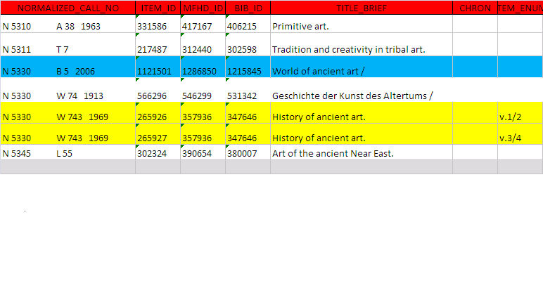
ALA 2010 : Cataloging for Weeding & Retention

Slide 14
ALA 2010 : Cataloging for Weeding & Retention

Slide 15
ALA 2010 : Cataloging for Weeding & Retention

Slide 16
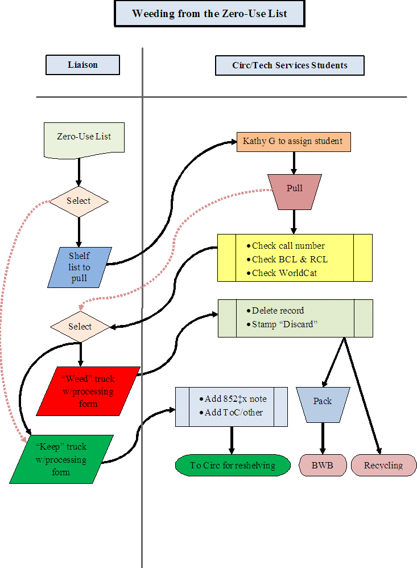
ALA 2010 : Cataloging for Weeding & Retention

Slide 17
ALA 2010 : Cataloging for Weeding & Retention
Print List
Pull from shelves
Check: RCL, BCL, WorldCat
Give to Librarian
Keep : notes (852 |x, ToC, access pts.)
Reject:
  Remove from local system (Voyager)
  Remove from OCLC
  Stamp – BWB or Recycle

Slide 18
ALA 2010 : Cataloging for Weeding & Retention
What to do with rejects?
  MacroExpress
    Voyager – delete item, mfhd, bib records

Slide 19
ALA 2010 : Cataloging for Weeding & Retention
What to do with rejects?
  MacroExpress
    Voyager – delete item, mfhd, bib records
    OCLC – remove symbol

Slide 20
ALA 2010 : Cataloging for Weeding & Retention
What to do with rejects?
  MacroExpress
  Divide discards
    Recycling
    Better World Books

Slide 21
ALA 2010 : Cataloging for Weeding & Retention
What to do with keepers?
    Notes
      852 |x staff side only notes
        BCL or RCL
        WorldCat
        Liaison decisions

Slide 22
ALA 2010 : Cataloging for Weeding & Retention
NOTES: The standard format will be
852 |x <reason for keeping> <liaisons’ initials> <date note is added to record>
Example: 852 |x BCL3 kec 3-10-10
This would mean that on March 10, 2010 Krista Clumpner decided to keep this item because it was listed in Books for College Libraries 3rd edition.

Slide 23
ALA 2010 : Cataloging for Weeding & Retention
NMU Olson Library Stacks Holdings with an 852 |x
Call Number MFHD_ BIB_ID
N 5300 .F48 1963 422855 411857
852X Brief Title
BCL1 10-19-09 kec Arts and ideas.

Slide 24
ALA 2010 : Cataloging for Weeding & Retention
Other examples of 852 x Notes :
  Only have, 12/21/09 kec
  BCL1 12/21/09 kec
  Keep- not in ARTstor 6/5/09 kec
  Only MI lib 10-19-09 kec

Slide 25
ALA 2010 : Cataloging for Weeding & Retention
What to do with keepers?
    Notes
      852 |x staff side only notes
      Table of Contents added
        Both to local record and OCLC record
        Example: Michelangelo / Charles De Tolnay
        505 1 |a 1. Youth.—2. The Sistine ceiling. –3. The Medici Chapel. –4. the tomb of Julius II. –5. The final period.

Slide 26
ALA 2010 : Cataloging for Weeding & Retention
What to do with keepers?
  Notes
    852 |x staff side only notes
    Table of Contents added
      Both to local record and OCLC record
      Example: Michelangelo / Charles De Tolnay
      505 1 |a 1. Youth.—2. The Sistine ceiling. –3. The Medici Chapel. –4. the tomb of Julius II. –5. The final period.
      Keyword Search

Slide 27
ALA 2010 : Cataloging for Weeding & Retention
What to do with keepers?
    Notes
      852 |x staff side only notes
      Table of Contents added
      Additional subject access
        Local record only
        Example: Group of Seven and Tom Thomson / Anne Newlands
          Added headings for each artist in the Group

Slide 28
ALA 2010 : Cataloging for Weeding & Retention
What to do with keepers?
    Notes
      852 |x staff side only notes
      Table of Contents added
      Additional subject access
      Mending, call number repair
      Back to shelf

Slide 29
ALA 2010 : Cataloging for Weeding & Retention
By 2015, reduce the main print book collection housed on the third floor by 50%.
Art & Design = 5,944
Zero Use Total = 1,974
Weeded = 1,296 (21.8%)

Slide 30
ALA 2010 : Cataloging for Weeding & Retention
Art & Design
  Zero Use Total = 1,974
  Weeded – 1,296
  66%

Slide 31
ALA 2010 : Cataloging for Weeding & Retention

Slide 32
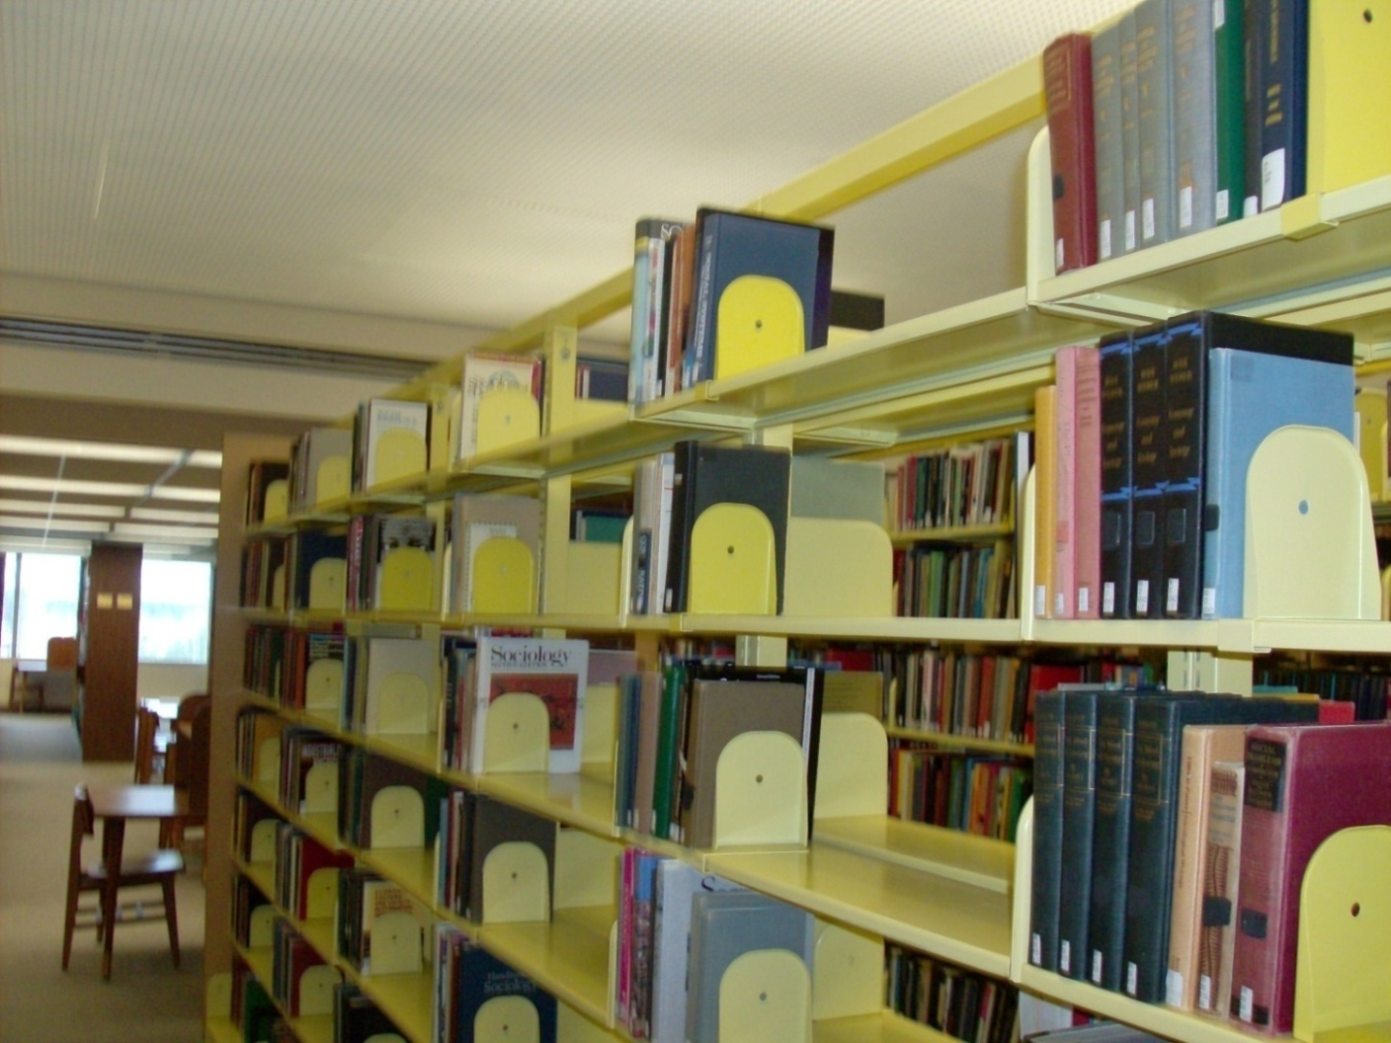
ALA 2010 : Cataloging for Weeding & Retention

Slide 33
ALA 2010 : Cataloging for Weeding & Retention
  852 Notes
    For future weeding – know why kept
    Determine what might go into storage
      Example:
        Not used locally
        Kept because less than 4 in Michigan
        May want to move to storage

Slide 34
ALA 2010 : Cataloging for Weeding & Retention
  Use of BCLs
    Relevant?
      Example:
        What % of BCL do we have in the collection?
        What % of BCL titles are used?

