Slide 1
WAAL 2010
Weeding Art: the art of weeding
Krista E. Clumpner
Head, Technical Services and Systems
Olson Library. Northern Michigan University
kclumpne@nmu.edu

Slide 2
WAAL 2010
Weeding Art: the art of weeding
Basic information: NMU
  4 year undergraduate with some Masters
  Approximately 9500 students
  Four colleges –
    College of Arts & Sciences
    College of Professional Studies
    College of Business
    Division of Academic Information Services
  One library with 734,003 items

Slide 3
WAAL 2010
Weeding Art: the art of weeding
  One library with 734,003 items
  80 – 20 rule
  Statistically true for entire collection.
  So, approximately 587,203 not used

Slide 4
WAAL 2010
Weeding Art: the art of weeding
By 2015, reduce the main print book collection housed on the third floor by 50%. Considerations include:
  Retaining sufficient collections to ensure that Interlibrary Loan and MeLCat lending are not jeopardized.
  Preserving significant collections: Holocaust and collections of local significance.
  Maintaining core discipline-centered collections.

Slide 5
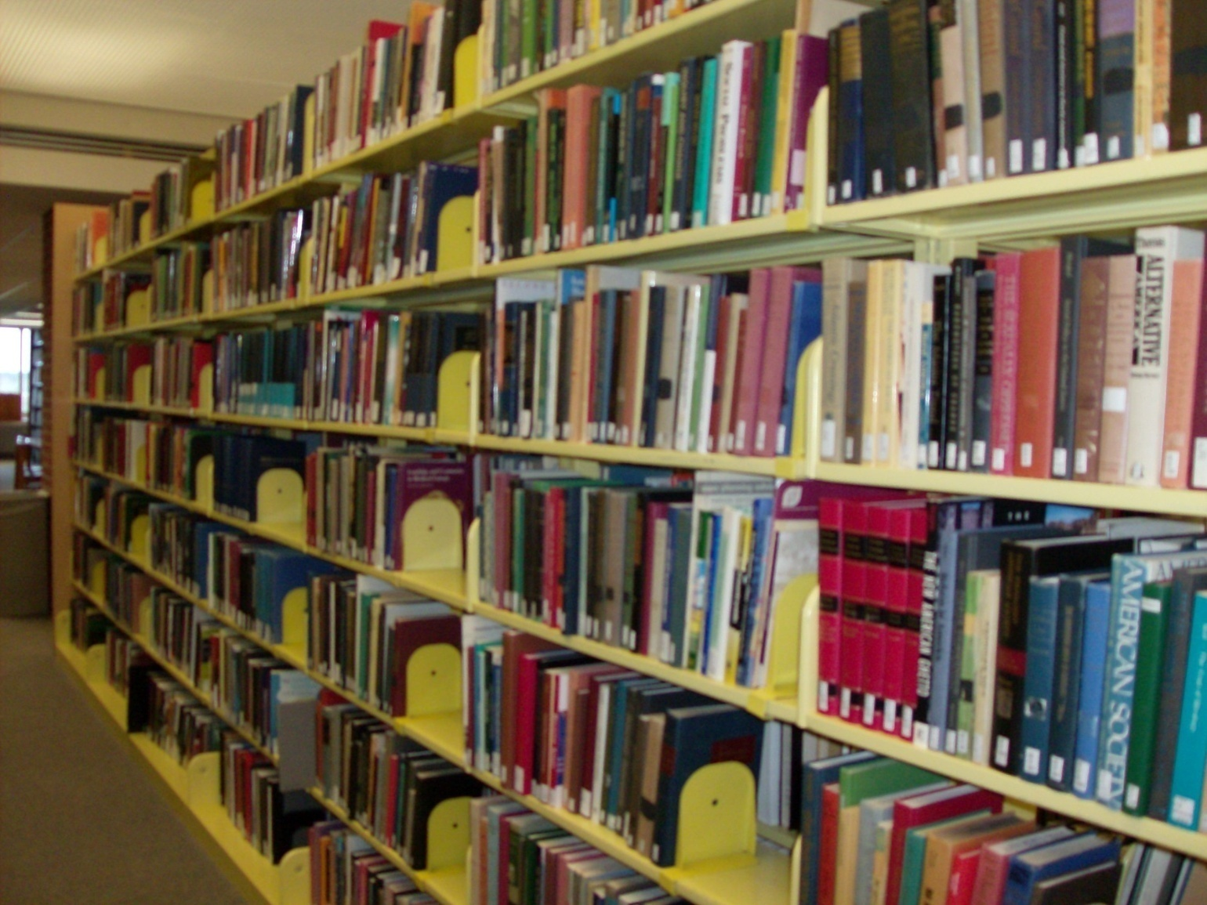
WAAL 2010
Weeding art: the art of weeding

Slide 6
WAAL 2010
Weeding art: the art of weeding
Art & Design
Total number of volumes = 11,887
Target = 50% = 5,944
Lots of Ifs
  50% applied evenly across the board - not
  All disciplines treated evenly - not
  It is just a guideline for a target
  What percentage of collection is art?

Slide 7
WAAL 2010
Weeding Art: the art of weeding

Slide 8
WAAL 2010
Weeding art: the art of weeding
What to weed? What to keep?
Zero-use items
  Check outs: circ history Fall 1991 to date
  Browses: since migration in April 2001
  ILL: handled through circulation so counted

Slide 9
WAAL 2010
Weeding art: the art of weeding
What to weed? What to keep?
Zero-use items
Classics
  Books for College Libraries (BCL)
    1st, 2nd, and 3rd editions in print
  Resources for College Libraries (RCL)
    On the web

Slide 10
WAAL 2010
Weeding art: the art of weeding
What to weed? What to keep?
Zero-use items
Classics
Unique titles
  NMU imprints
  NMU Faculty publications
  WorldCat
    How many within Michigan hold?
    Four or more = not unique

Slide 11
WAAL 2010
Weeding art: the art of weeding
What to weed? What to keep?
Zero-use items
Classics
Unique titles
Duplication of content
  Compare print to databases
    ArtStor vs. Museum Collections

Slide 12
WAAL 2010
Weeding art: the art of weeding
Process:
  Using the zero-use list
  Pulled from Voyager
    Call number sort
    Title
    Enum/chron information
    Only items with no circ check outs or browses

Slide 13
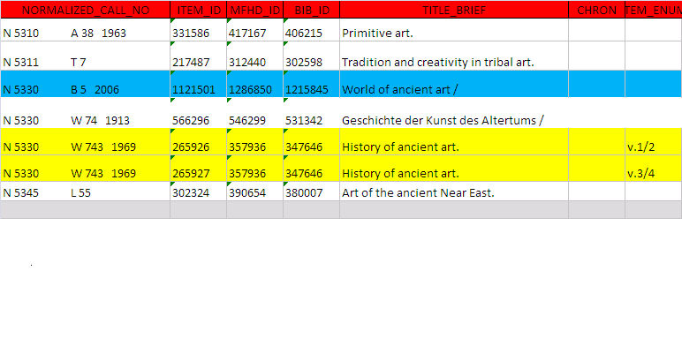
WAAL 2010
Weeding art: the art of weeding

Slide 14
WAAL 2010
Weeding art: the art of weeding

Slide 15
WAAL 2010
Weeding art: the art of weeding

Slide 16
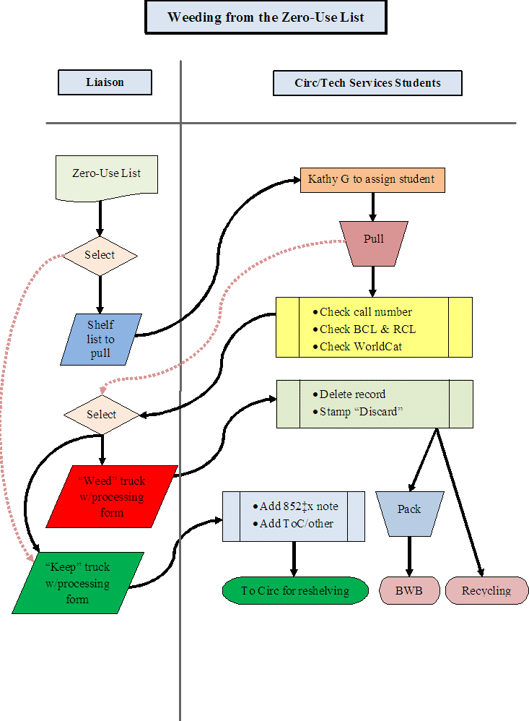

Slide 17

WAAL 2010
Weeding art: the art of weeding

Slide 18
WAAL 2010
Weeding art: the art of weeding

Slide 19
WAAL 2010
Weeding art: the art of weeding

Slide 20
WAAL 2010
Weeding art: the art of weeding
What to do with rejects?
  MacroExpress
    Voyager – delete item, mfhd, bib records
    OCLC – remove symbol

Slide 21
WAAL 2010
Weeding art: the art of weeding
What to do with rejects?
  MacroExpress
  Divide discards
    Recycling
    Better World Books

Slide 22
WAAL 2010
Weeding art: the art of weeding
What to do with keepers?
    Notes
      852 |x staff side only notes
        BCL or RCL
        WorldCat
        Liaison decisions

Slide 23
WAAL 2010
Weeding art: the art of weeding
NOTES: The standard format will be
852 |x <reason for keeping> <liaisons’ initials> <date note is added to record>
Example: 852 |x BCL3 kec 3-10-10
This would mean that on March 10, 2010 Krista Clumpner decided to keep this item because it was listed in Books for College Libraries 3rd edition.

Slide 24
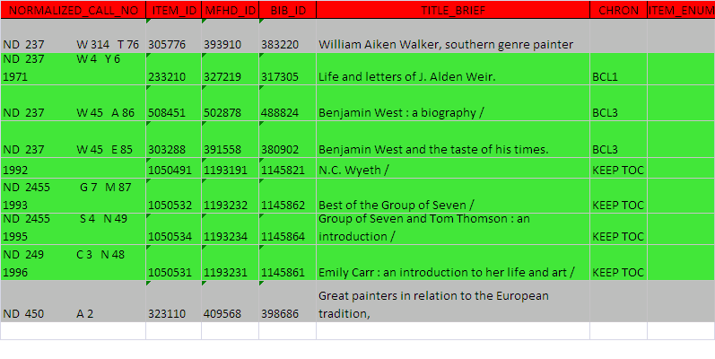
WAAL 2010
Weeding art: the art of weeding

Slide 25
WAAL 2010
Weeding art: the art of weeding

Slide 26
WAAL 2010
Weeding art: the art of weeding
What to do with keepers?
    Notes
      852 |x staff side only notes
      Table of Contents added
        Both to local record and OCLC record
        Example: Michelangelo / Charles De Tolnay
        505 1 |a 1. Youth.—2. The Sistine ceiling. –3. The Medici Chapel. –4. the tomb of Julius II. –5. The final period.

Slide 27
WAAL 2010
Weeding art: the art of weeding
What to do with keepers?
    Notes
      852 |x staff side only notes
      Table of Contents added
        Both to local record and OCLC record
        Example: Michelangelo / Charles De Tolnay
        505 1 |a 1. Youth.—2. The Sistine ceiling. –3. The Medici Chapel. –4. the tomb of Julius II. –5. The final period.
        Keyword Search

Slide 28
WAAL 2010
Weeding art: the art of weeding
What to do with keepers?
    Notes
      852 |x staff side only notes
      Table of Contents added
      Additional subject access
        Local record only
        Example: Group of Seven and Tom Thomson / Anne Newlands
          Added headings for each artist in the Group

Slide 29
WAAL 2010
Weeding art: the art of weeding
What to do with keepers?
    Notes
      852 |x staff side only notes
      Table of Contents added
      Additional subject access
      Mending, call number repair
      Back to shelf

Slide 30
WAAL 2010
Weeding Art: the art of weeding
By 2015, reduce the main print book collection housed on the third floor by 50%.
Art & Design = 5,944
Zero Use Total = 1,974
Weeded = 1,296

Slide 31
WAAL 2010
Weeding art: the art of weeding

Slide 32
WAAL 2010
Weeding Art: the art of weeding
Art & Design
  Zero Use Total = 1,974
  Weeded – 1,296
  66%

Slide 33
WAAL 2010
Weeding art: the art of weeding

Slide 34
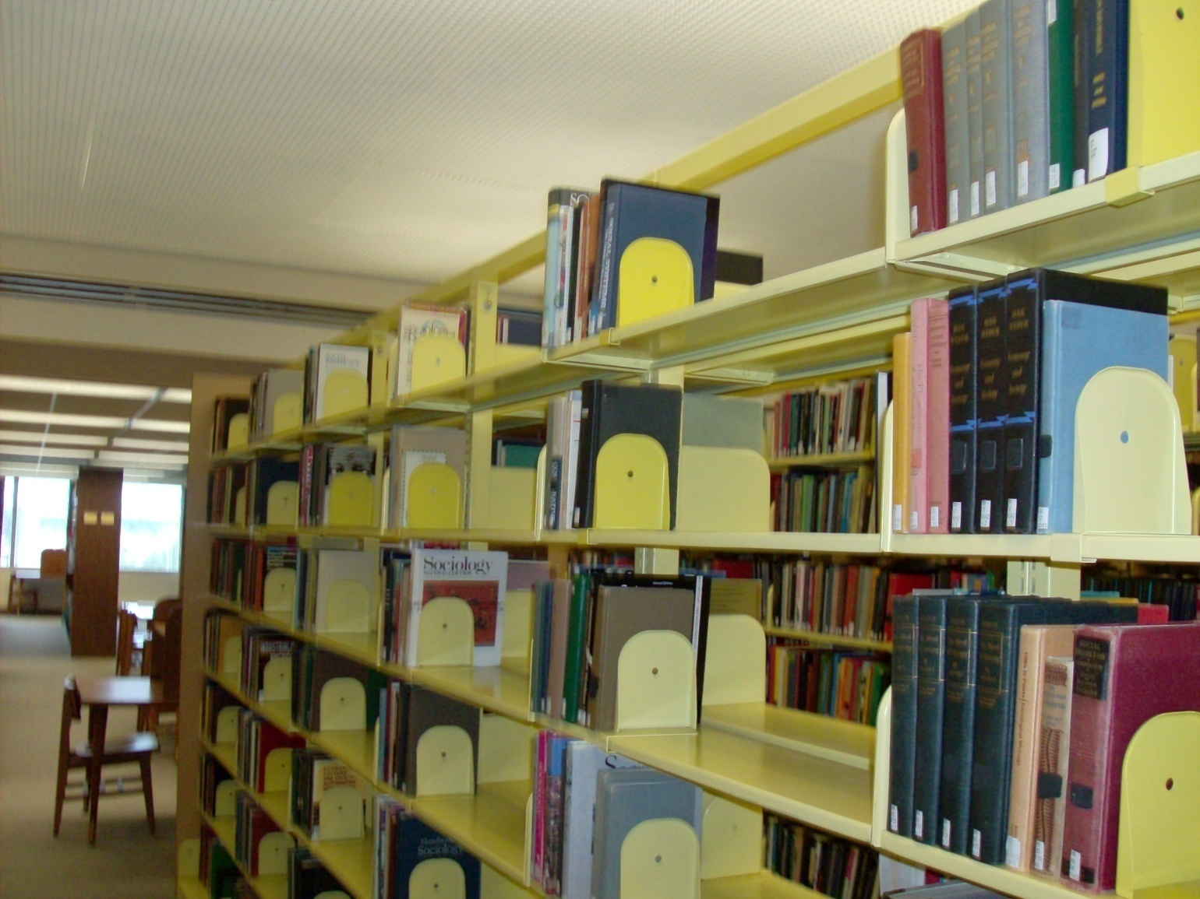
WAAL 2010
Weeding art: the art of weeding

Slide 35
WAAL 2010
Weeding Art: the art of weeding
Assessment
What worked well?
  852 Notes
    For future weeding – know why kept
    Determine what might go into storage
      Policy needed

Slide 36
WAAL 2010
Weeding Art: the art of weeding
Assessment
What would I change?
  Use of BCLs
    Relevant?

Slide 37
WAAL 2010
Weeding Art: the art of weeding
Next stage –
  Find another 4,648 or so
  Got Ideas?

